Slide 1
Chapter 3 Acceleration Lecture 1

Slide 2
Chapter 3: Acceleration
Chapter Goal: To extend the description of motion in one dimension to include changes in velocity. This type of motion is called acceleration.

Slide 3
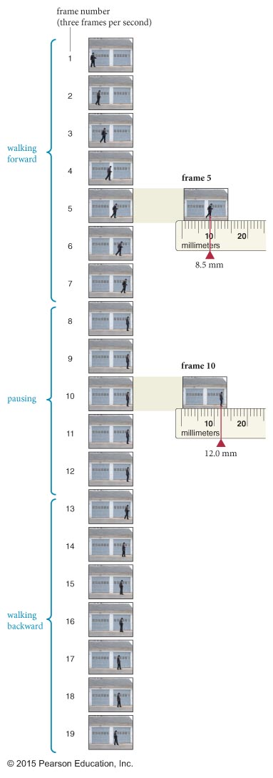
Chapter 2 Review
Looking Back: Visualizing motion
The motion of an object can be determined by looking at its location in individual frames of a film clip recorded at equally spaced times.

Slide 4
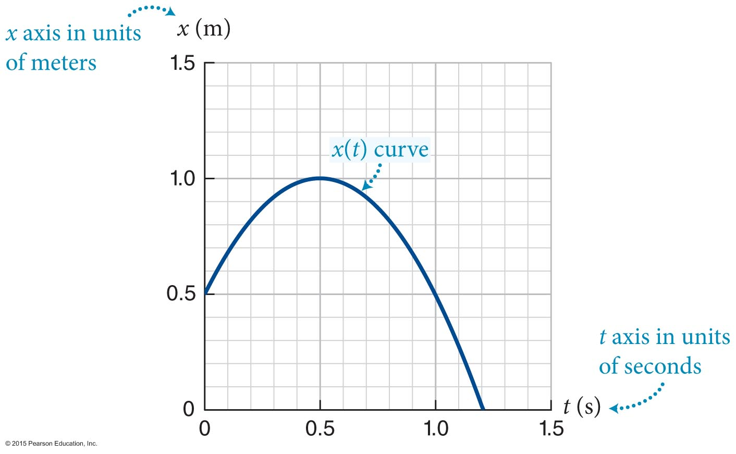
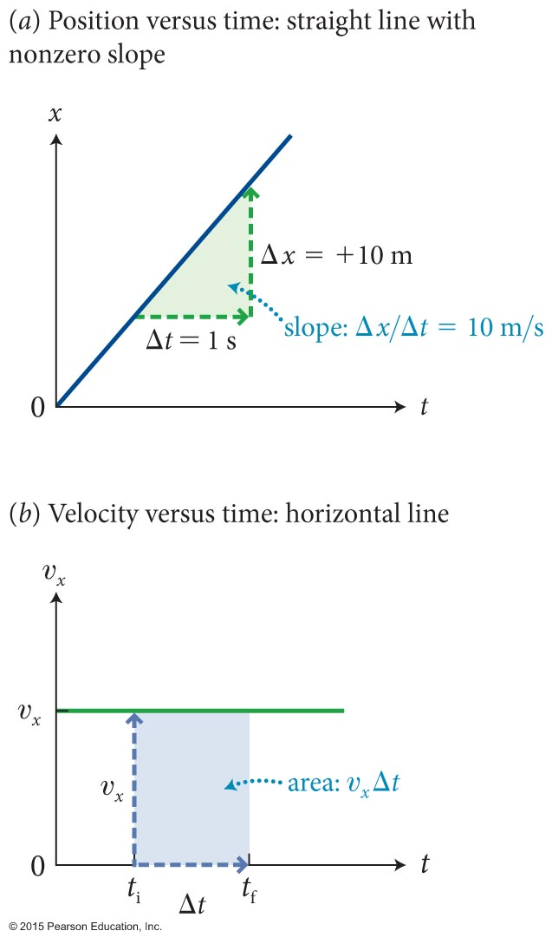
Chapter 2 Review
Looking Back: Representations of motion
Graphical and mathematical ways of representing motion.
velocity is the derivative of displacement
displacement is the integral of velocity

Slide 5
Section 3.1: Changes in velocity: Acceleration
If an object’s velocity is changing, the object is accelerating.
The x component of the average acceleration of an object is the change in the x component of the velocity divided by the time interval during which this change took place.
The SI unit of acceleration is m/s².
acceleration
10 m/s²
0 m/s
0 s
1 s
2 s
time

Slide 6
Chapter 3 Acceleration
Representations of motion
Graphical and mathematical ways of representing motion.
change in velocity is the integral of acceleration
velocity is the derivative of displacement
acceleration
10 m/s²
displacement is the integral of velocity
0 m/s
0 s
1 s
2 s
time

Slide 7
Checkpoint 3.1
The x component of a car’s velocity increases from 0 to +5.0 m/s in 1.0 s, and then from +5.0 m/s to +10 m/s in the next 2.0 s. What is the x component of its average acceleration (a) during the first second, (b) during the last 2 seconds, and (c) during the entire 3.0-s interval?
3.1
velocity
10 m/s
5 m/s
0 m/s
0 s
1 s
2 s
3 s
time

Slide 8
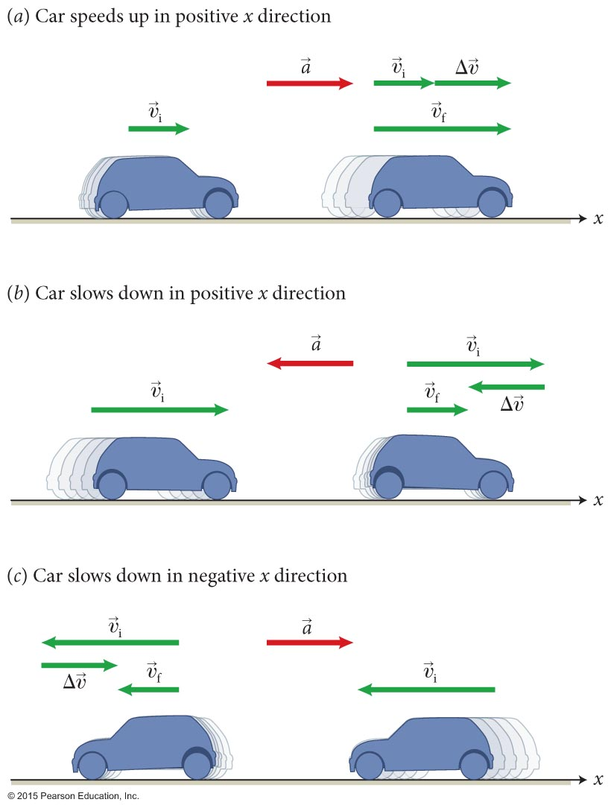
Section 3.1: Changes in velocity
Whenever an object’s velocity vector and acceleration vector point in the same direction, the object speeds up.
If and point in the opposite direction, the object slows down.

Slide 9
Checkpoint 3.2
The x component of the velocity of a car changes from –10 m/s to –2.0 m/s in 10 s. (a) Is the car traveling in the positive or negative x direction? (b) Does point in the positive or negative x direction? (c) Is the x component of the car’s acceleration positive or negative? (d) Is the car speeding up or slowing down?
3.2
-2 m/s
-10 m/s

Slide 10
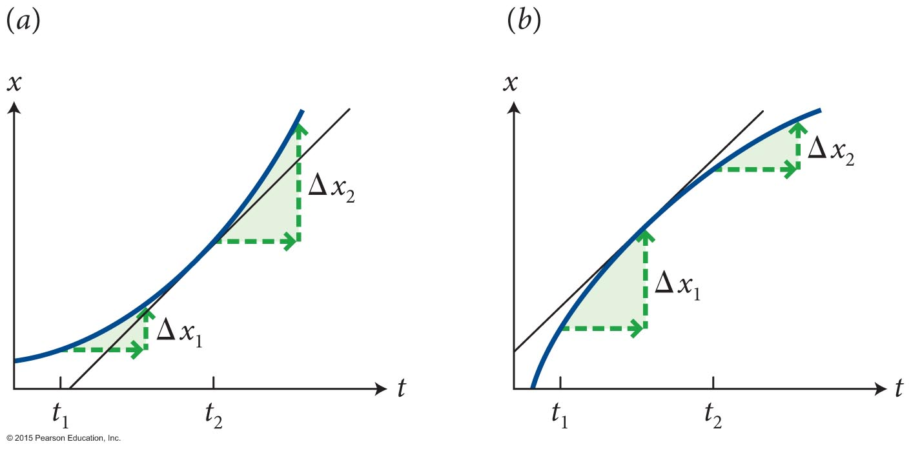
Section 3.1: Changes in velocity
For accelerating objects, the x(t) curve is a not a straight line.
The figure shows the x(t) curve for two accelerating objects:
For each object, consider the displacements Δx₁ and Δx₂ during two equal time intervals (Δt) at two different times.
If the displacement increases with time then the velocity is increasing (for example, Δx₂ > Δx₁).
If the displacement decreases then velocity is decreasing.

Slide 11
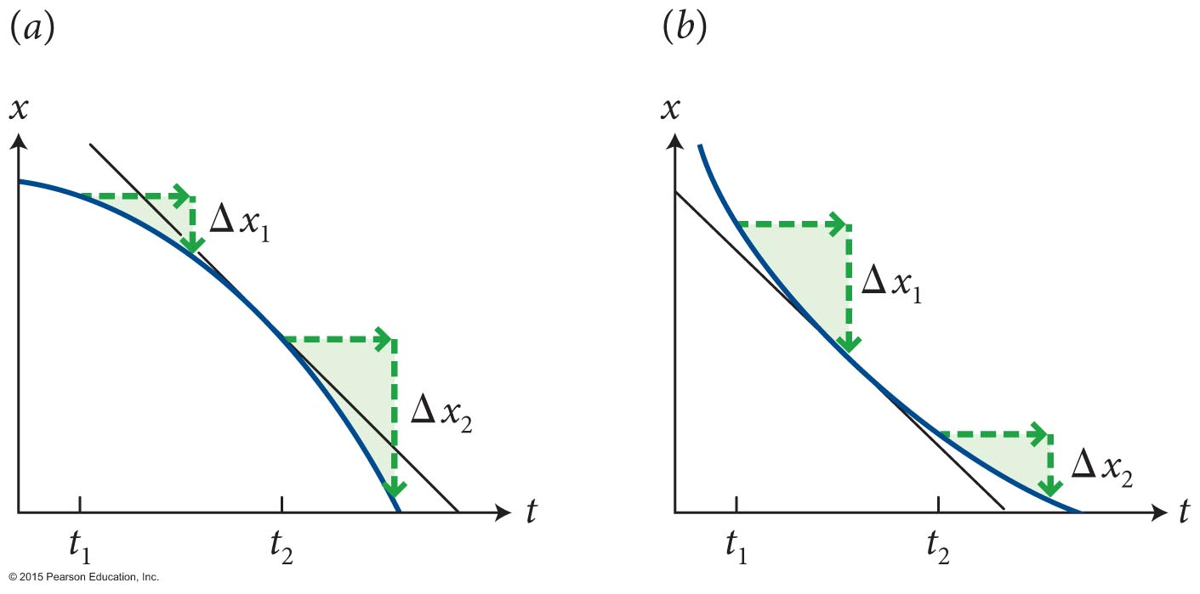
Checkpoint 3.3
(a) Are the x components of the velocity represented by the x(t) curves positive or negative? (b) Are the speeds increasing or decreasing? (c) Are the x components of positive or negative? (d) Are the x components of the acceleration positive or negative?
3.3
(a) x_{i} > x_{f} ; negative
(b) Left increasing; Right decreasing
(c) Left negative
Right positive
(d) Left negative; Right positive

Slide 12
Section 3.1: Changes in velocity
The curvature of the x(t) curve is a measure of the x component of acceleration (a_{x}).
An upward curvature corresponds to a positive a_{x}:
The curve lies above the tangent (1 and 4).
A downward curvature corresponds to a negative a_{x}:
The curve lies below the tangent (2 and 3).
1
2
3
4

Slide 13
Section 3: Checkpoint 3.4
To which of the four graphs does the situation by the drawings of the car correspond?
3.4
-2 m/s
-10 m/s
a
b
c
d
Notes:
Did first 13 slides in one lecture with no LC or Perusall or demonstration.

Slide 14
Chapter 3 Acceleration Lecture 2

Slide 15
Section 3.2: Acceleration due to gravity
An object falling in a straight line toward the Earth’s surface is an example of an accelerated motion.
The figure shows the positions of a falling ball recorded at equal time intervals of 0.05 s.
The increasing displacements of the ball during the motion tells us that the speed increases as it falls: The ball accelerates.

Slide 16
Checkpoint Question 3.5
Does the acceleration of an object as it falls depend on the physical characteristics of the object?
Hold a book and a sheet of paper, cut to the same size as the book, side by side 1 m above the floor. Hold the paper parallel to the floor and the book with its covers parallel to the floor, and release them at the same instant. Which hits the floor first? Now put the paper on top of the book and repeat the experiment. What do you notice?
3.5

Slide 17
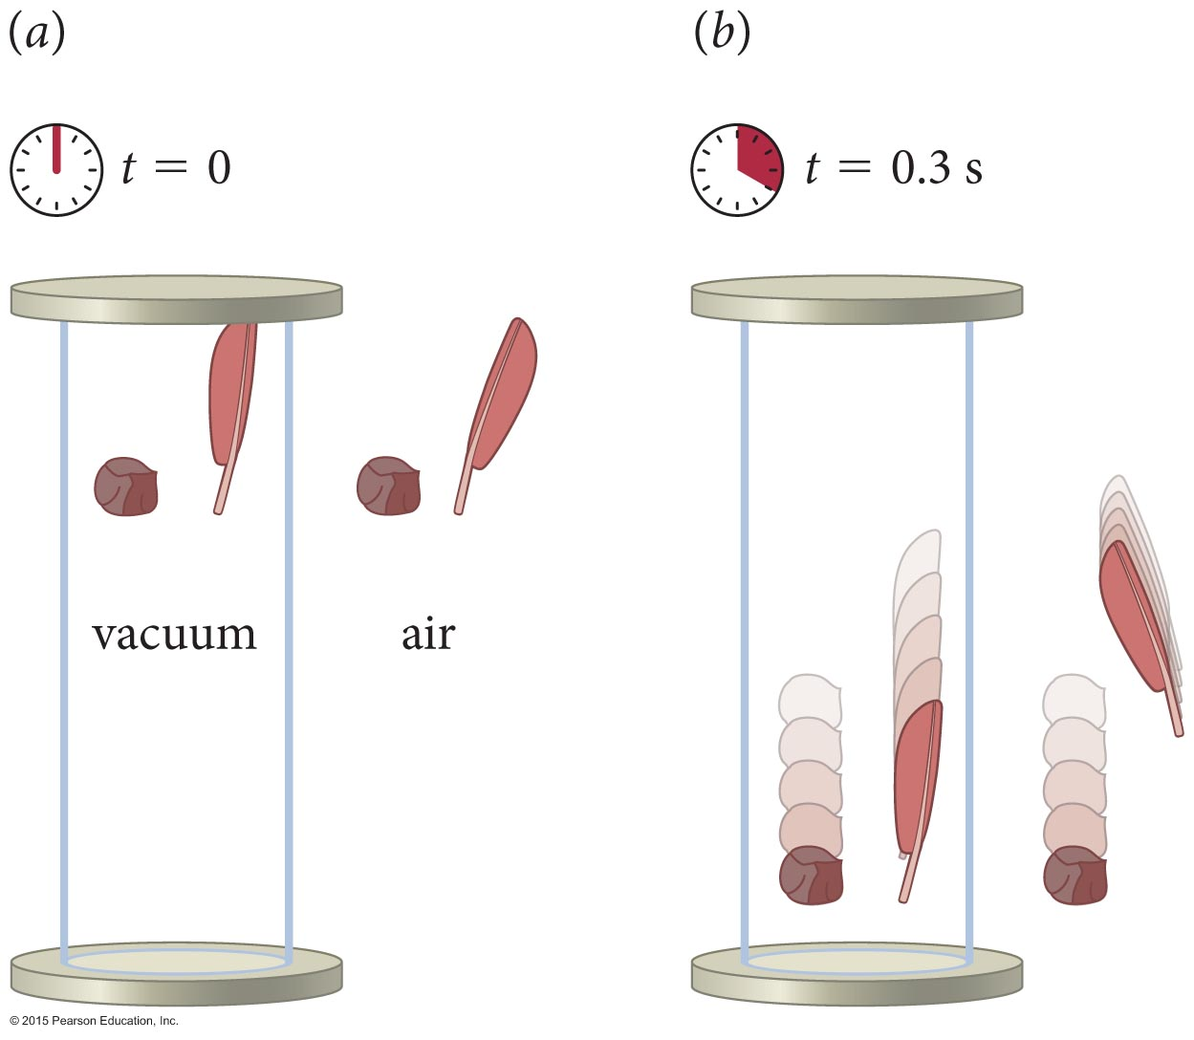
Section 3.2: Acceleration due to gravity
What is the magnitude of acceleration due to gravity as an object falls?
The figure shows the effect of air resistance on a falling stone and a falling feather.
We see that in a vacuum in the absence of air resistance, the acceleration due to gravity does not depend on the physical characteristics of object:
The motion of an object under the influence of gravity only is called free fall.
http://www.iflscience.com/physics/dropping-bowling-ball-and-feather-vacuum

Slide 18
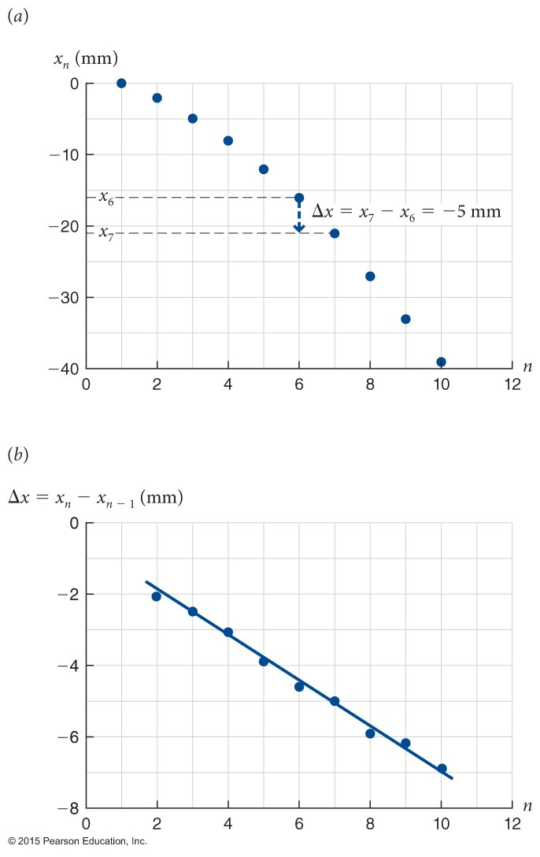
Section 3.2: Acceleration due to gravity
What is the magnitude of acceleration due to gravity as an object falls?
The positions-versus-time graph of the falling ball is shown in part (a) of the figure.
Part (b) shows the displacement Δx = x_{f} – x_{i} for each successive 0.05 s time interval.
The data points lie on a straight line, which indicates that the displacement increases at a constant rate.
Therefore, the velocity increases at a constant rate.

Slide 19
Section 3.2: Acceleration due to gravity
What is the magnitude of acceleration due to gravity as an object falls?
Experiments show that in the absence of air resistance, the magnitude of the acceleration of all falling objects is 9.8 m/s².
Consequently the amount of time it takes to fall from a certain height is the same for all falling objects.

Slide 20
Checkpoint 3.7
(a) Does the speed of a falling object increase or decrease?
(b) If the positive x axis points up, does υ_{x} increase or decrease as the object falls?
(c) Is the x component of the acceleration positive or negative?
3.7
(a) speed increases
+v_{x}
(b) v_{x} decreases
(c) a_{x} negative

Slide 21
Section 3.3: Projectile motion
An object that is launched but not self-propelled is called a projectile.
Its motion is called projectile motion.
The path the object follows is called its trajectory.

Slide 22
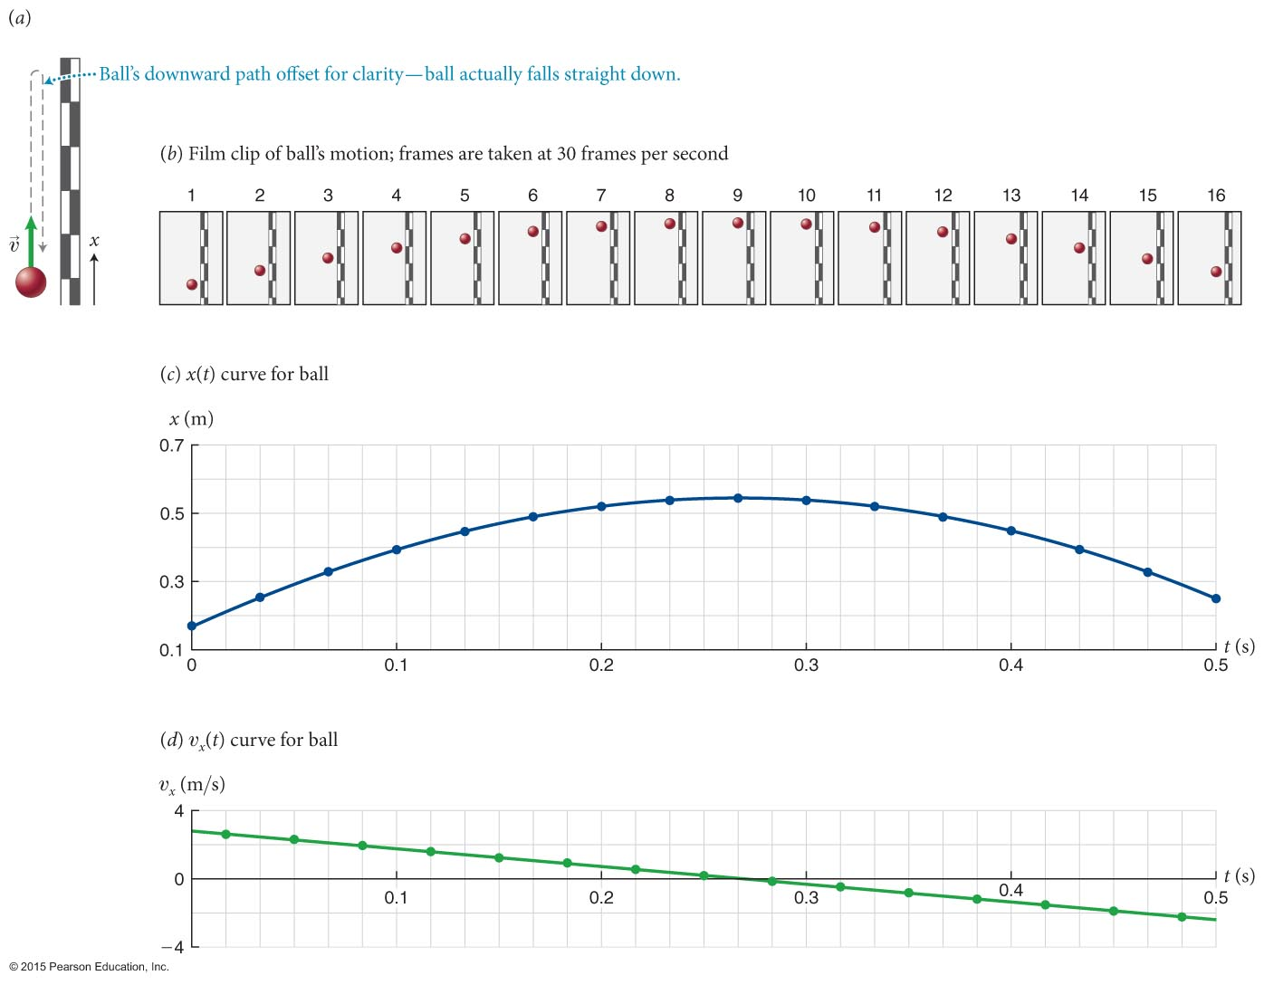
Section 3.3: Projectile motion

Slide 23
Section 3.3: Projectile motion

Slide 24
Section 3.3: Projectile motion
What happens at the very top of the trajectory of a ball launched upward?
At the top, velocity changes from up to down, which means that acceleration must be nonzero.
At the very top, the instantaneous velocity is zero.

Slide 25
Checkpoint 3.8
Imagine throwing a ball downward so that it has an initial speed of 10 m/s. What is its speed 1 s after you release it? 2 s after?
3.8
v_{x,i} = -10m/s
v_{x,f} = -20 m/s
v_{x,f} = -30 m/s

Slide 26
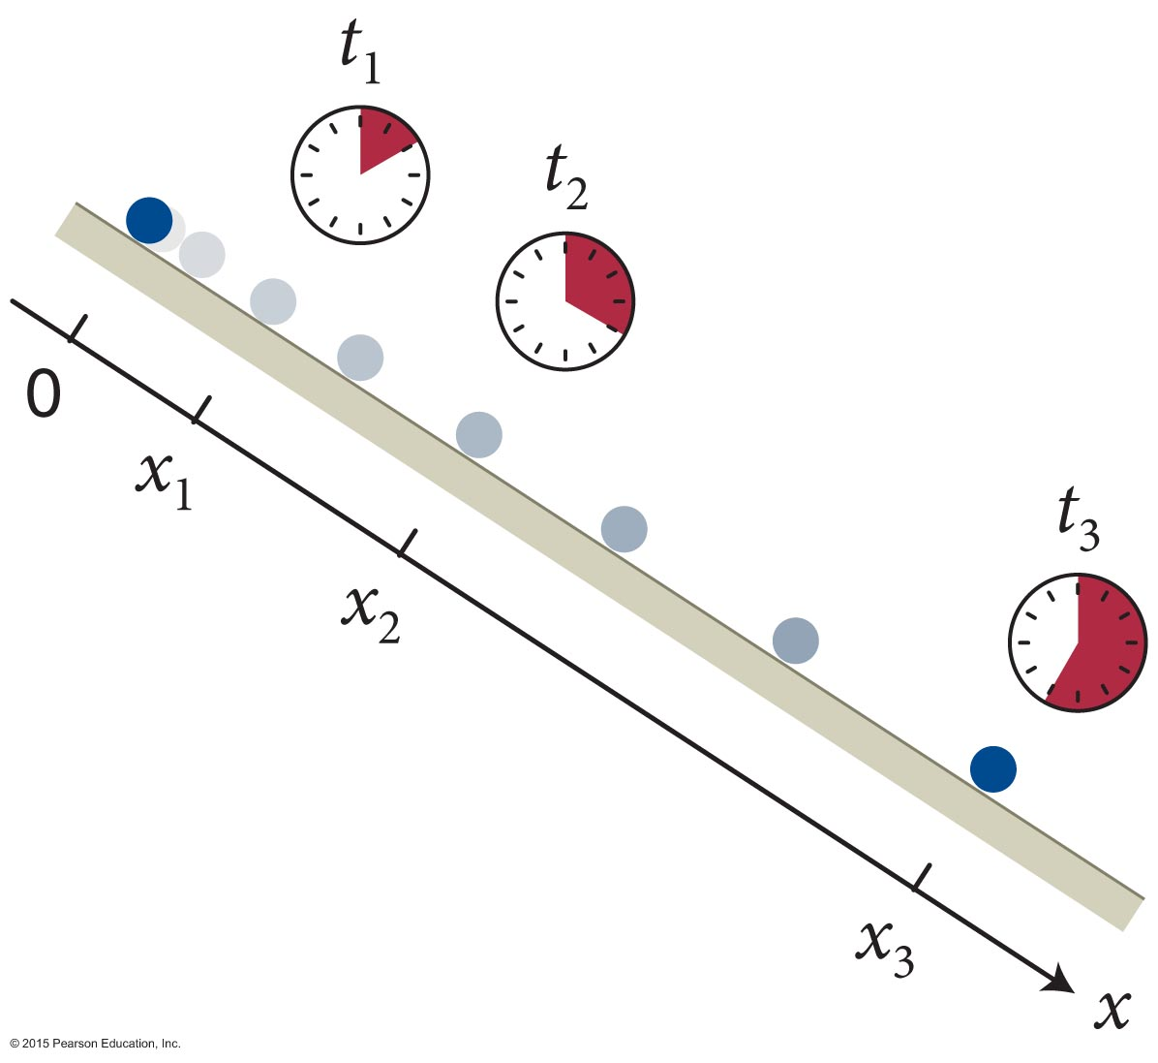
Section 3.7: Inclined planes
Galileo used inclined planes to study motion of objects that are accelerated due to gravity:
He found that when a ball rolls down an incline starting at rest, the ratio of the distance traveled to the square of the amount of time needed to travel that distance is constant:
This ratio is proportional to a_{x}:

Slide 27
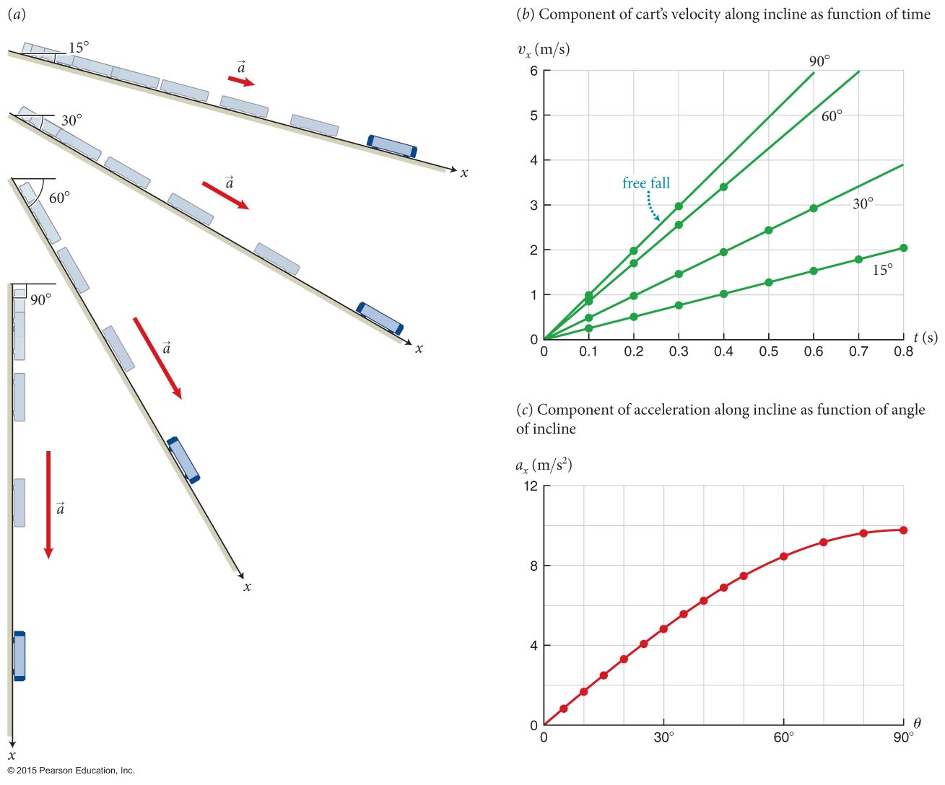
Section 3.7: Inclined planes
Galileo observed that
For each value of the angle θ, a_{x} along the incline is a constant.
a_{x} along the incline increases as θ increases.
Experimentally a_{x} = +g sin θ

Slide 28
Chapter 3 Acceleration Lecture 3
Notes:
LC.
Login to LC on classroom computer.
Login to LC on laptop. Student view on laptop

Slide 29
Section 3.5: Motion with constant acceleration
We can write down the definition for the x component of average acceleration:
Notice the similarity between this definition and the definition of average velocity in chapter 2:

Slide 30
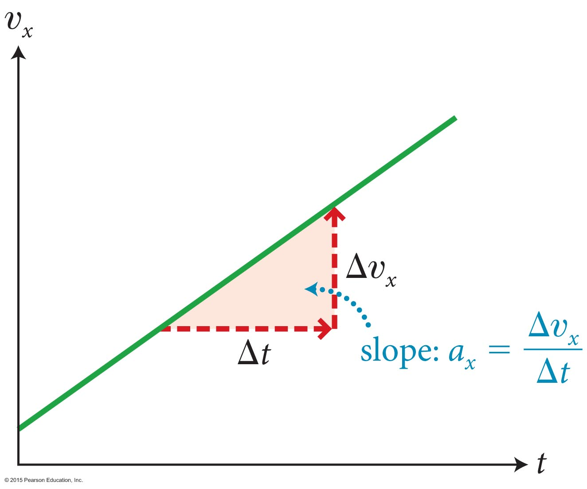
Section 3.5: Motion with constant acceleration
Now let us consider the motion of an object with constant acceleration:
For motion with constant acceleration, a_{x,av} = a_{x} and υ_{x}(t) curve is a straight line.
The x-component of final velocity:

Slide 31
Section 3.5: Motion with constant acceleration
The displacement of the object is equal to the area (integral) under the velocity υ_{x}(t) curve.
For an object in motion with constant acceleration, the displacement (Δx = x_{f} – x_{i}) in time interval (Δt = t_{f} – t_{i}) is given by the area of the shaded trapezoid.
A₂
A₁

Slide 32
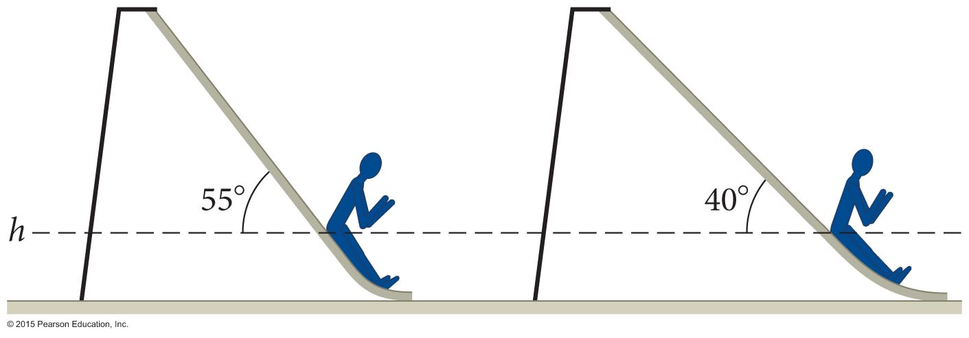
Section 3.7
Clicker Question 11
Two children at a playground slide from rest down slides that are of equal height but are inclined at different angles with respect to the horizontal as shown in the figure. Ignoring friction, at height h above the ground, which child has the greater speed?
The child on the left
The child on the right
Both have the same speed.
We need additional information.

Slide 33
Section 3.5: Motion with constant acceleration
Δx₁
Δx₂
h
h
θ₁
θ₂

Slide 34
Section 3.5: Motion with constant acceleration
Δx₁
Δx₂
h
h
θ₁
θ₂

Slide 35
Section 3.7
Clicker Question 11
Two children at a playground slide from rest down slides that are of equal height but are inclined at different angles with respect to the horizontal as shown in the figure. Ignoring friction, at height h above the ground, which child has the greater speed?
The child on the left
The child on the right
Both have the same speed.
We need additional information.

Slide 36
Section 3.7
Clicker Question 11
Two children at a playground slide from rest down slides that are of equal height but are inclined at different angles with respect to the horizontal as shown in the figure. Ignoring friction, at height h above the ground, which child has the greater speed?
The child on the left
The child on the right
Both have the same speed.
We need additional information.

Slide 37
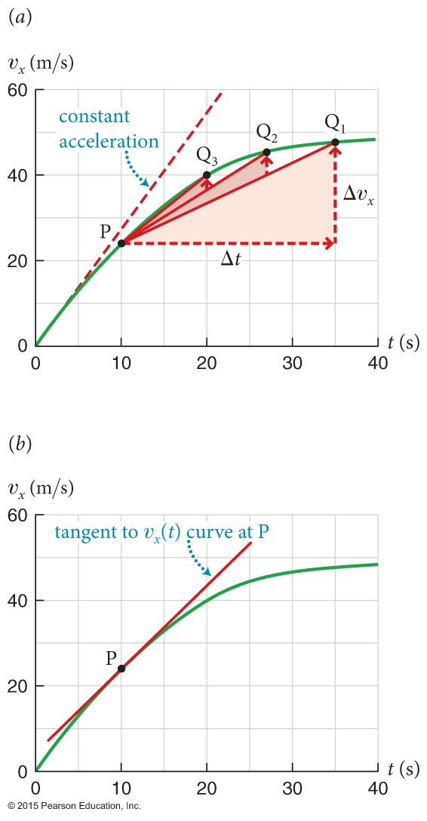
Section 3.8: Instantaneous acceleration
What if acceleration is not constant?
The figure shows the υ_{x}(t) curve for a motion where the acceleration is not constant.
The instantaneous acceleration a_{x} is the slope of the tangent of the υ_{x}(t) curve at time t:
Or

Slide 38
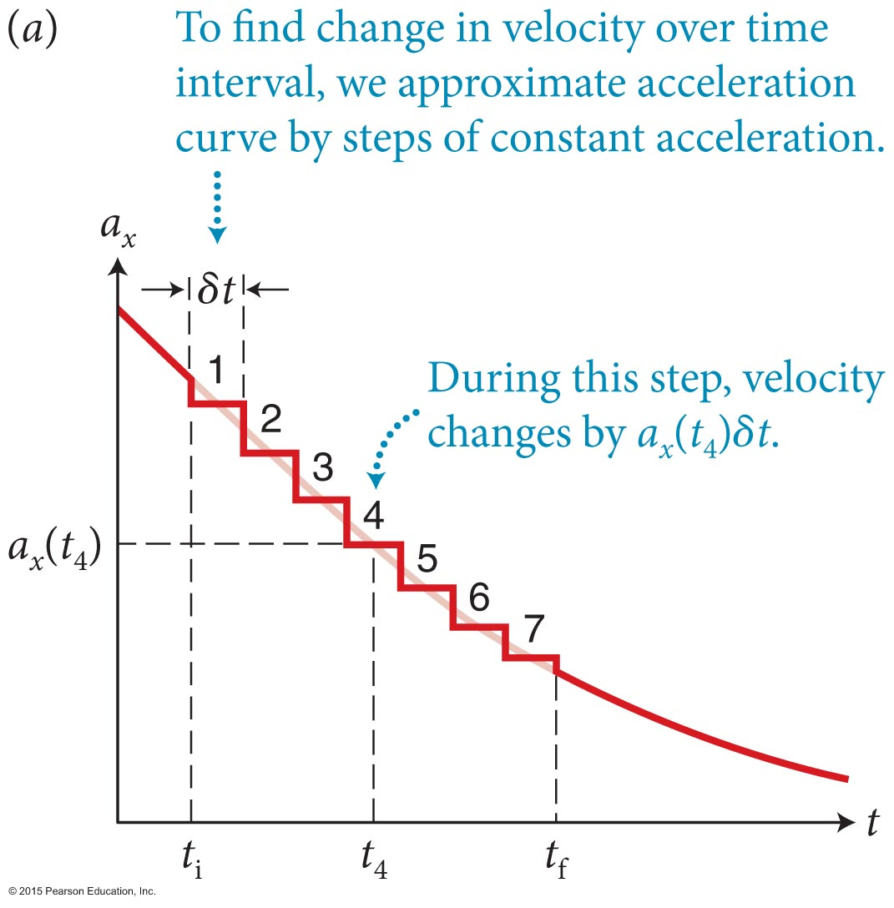
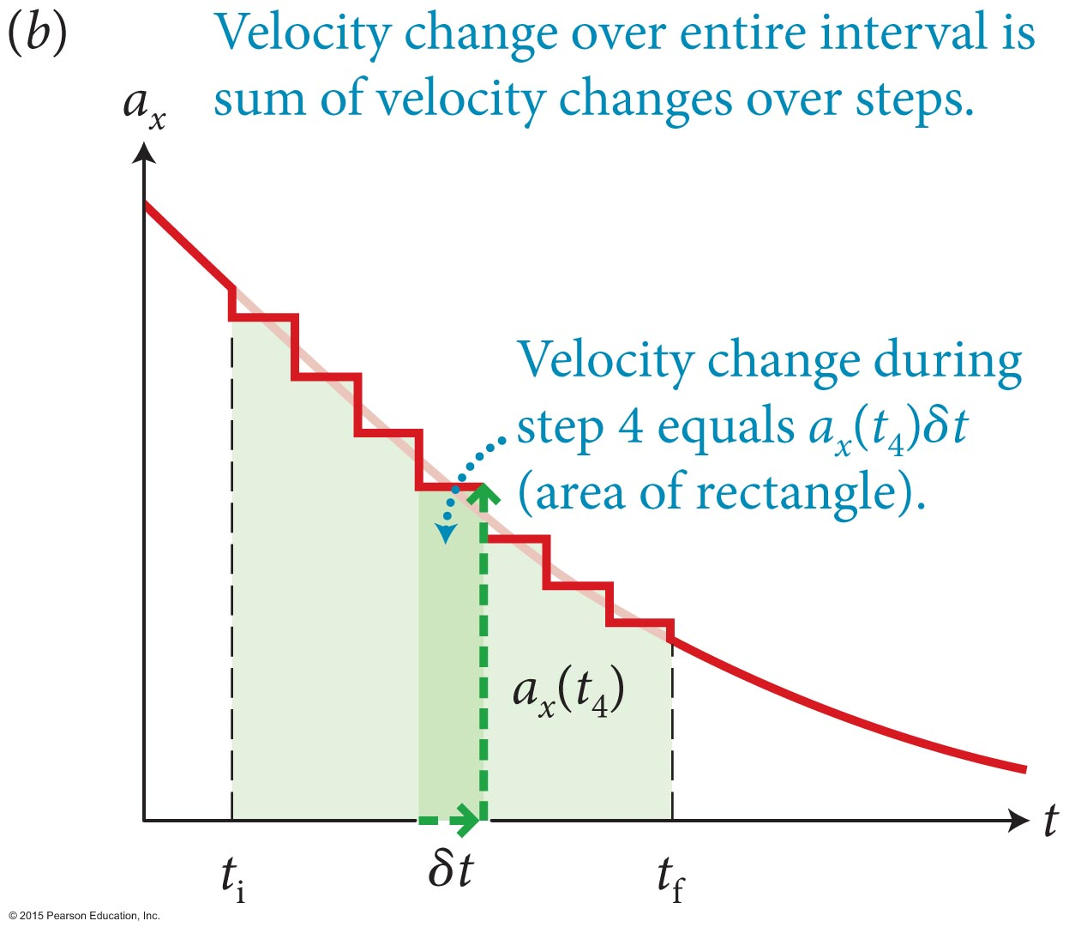
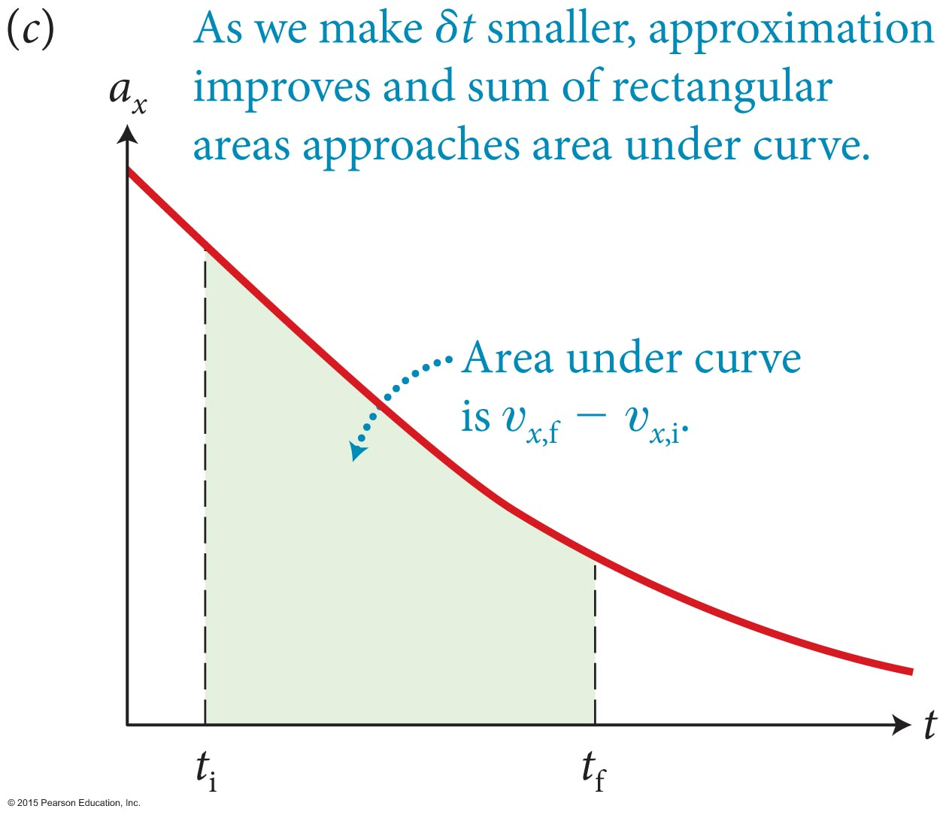
Section 3.8: Instantaneous acceleration
To find the change in velocity during the time interval (Δt), we can use the area under the a_{x}(t) curve in the figure.
Although, acceleration is not constant, we can divide motion into small intervals of Δt in which it is constant.
In the limit Δt ⟶ 0, we can find

Slide 39
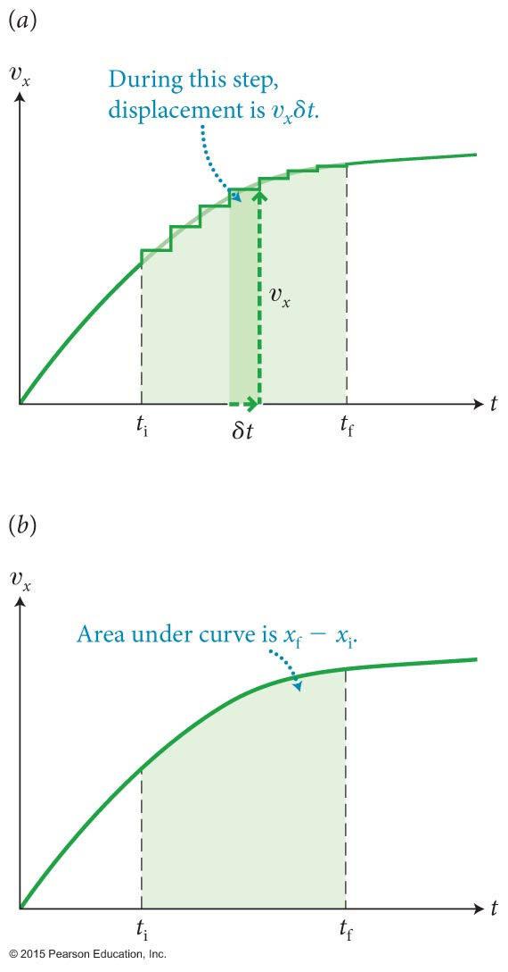
Section 3.8: Instantaneous acceleration
Once we know the velocity, we can use the same approach to obtain displacement:
Δx = υ_{x} Δt (constant velocity)

Slide 40
Exercise 3.7 Using calculus to determine displacement
Section 3.8: Instantaneous acceleration
Suppose an object initially at x_{i} at t_{i} = 0 has a constant acceleration whose x component is a_{x}. Use calculus to show that the x component of the velocity and the x coordinate at some final instant t_{f} are given by Eqs. 3.10 and Eq. 3.9, respectively.

Slide 41
Exercise 3.7 Using calculus to determine displacement (cont.)
Section 3.8: Instantaneous acceleration
SOLUTION Because the acceleration is constant, I can pull a_{x} out of the integration in Eq. 3.27:
Substituting t_{i} = 0 and rearranging terms, I obtain Eq. 3.10:
✔

Slide 42
Exercise 3.7 Using calculus to determine displacement (cont.)
Section 3.8: Instantaneous acceleration
SOLUTION For an arbitrary final instant t, I can drop the subscript f. Substituting this expression into Eq. 3.28, I get
or, pulling constant terms out of the integration and then carrying out the integration,
which yields Eq. 3.9:
✔

Slide 43
Checkpoint 3.14: Constant acceleration
Take the first and second time derivatives of x_{f} in Eq. 3.9. What do you notice?
3.14
position
velocity

Slide 44
Checkpoint 3.14
: Constant acceleration
Take the first and second time derivatives of x_{f} in Eq. 3.9. What do you notice?
3.14
position
velocity
acceleration

Slide 45
Concepts: Accelerated motion
Chapter 3: Summary
If the velocity of an object is changing, the object is accelerating. The x component of an object’s average acceleration is the change in the x component of its velocity divided by the time interval during which this change takes place.
The x component of the object’s instantaneous acceleration is the x component of its acceleration at any given instant.
A motion diagram shows the positions of a moving object at equally spaced time intervals.

Slide 46
Quantitative Tools: Accelerated motion
Chapter 3: Summary
The x component of the average acceleration is
The x component of the instantaneous acceleration is
The x component of the change in velocity over a time interval is given by
The x component of the displacement over a time interval is given by

Slide 47
Concepts: Motion with constant acceleration
Chapter 3: Summary
If an object has constant acceleration, the υ_{x}(t) curve is a straight line that has a nonzero slope and the a_{x}(t) curve is a horizontal line.
velocity
acceleration
4 m/s
10 m/s²
-4 m/s
0 m/s²
0 s
1 s
2 s
time

Slide 48
Quantitative Tools: Motion with constant acceleration
Chapter 3: Summary
If an object moves in the x direction with constant acceleration a_{x} starting at t = 0, with initial velocity υ_{x,i} at initial position x_{i}, its x coordinate at any instant t is given by
The x component of its instantaneous velocity is given by
And the x component of its final velocity is given by

Slide 49
Concepts: Free fall and projectile motion
Chapter 3: Summary
An object subject only to gravity is in free fall. All objects in free fall near the surface of Earth have the same acceleration, which is directed downward. We call this acceleration the acceleration due to gravity and denote its magnitude by the letter g.
An object that is launched but not self-propelled is in projectile motion. Once it is launched, it is in free fall. The it follows is called its trajectory.

Slide 50
Quantitative Tools: Free fall and projectile motion
Chapter 3: Summary
The magnitude g of the downward acceleration due to gravity is

Slide 51
Concepts: Motion along an inclined plane
Chapter 3: Summary
An object moving up or down an inclined plane on which friction is negligible has a constant acceleration that is directed parallel to the surface of the plane and points downward along the surface.
The x component of acceleration a_{x} for an object moving on an inclined plane that rises at an angle θ above the horizontal is
a_{x} = +g sin θ
when the x axis is directed downward along the plane.

